Slide 1
Reccurrence Relation

Slide 2
Reccurrence Relation
A recurrence relation is an equation which is defined in terms of itself
A recurrence relation (or recurrence) is an equation or inequality that describes a function in terms of its value on smaller inputs.
Reccurence relation is explained with the help of binary search.

Slide 3
BINARY SEARCH ALGORITHM
Recursive Method
binarySearch(arr, x, low, high)
if low > high
return False
Else
mid = (low + high) / 2
if x == arr[mid]
return mid
else if x > arr[mid] // x is on the right side
return binarySearch(arr, x, mid + 1, high)
else // x is on the left side
return binarySearch(arr, x, low, mid - 1)

Slide 4
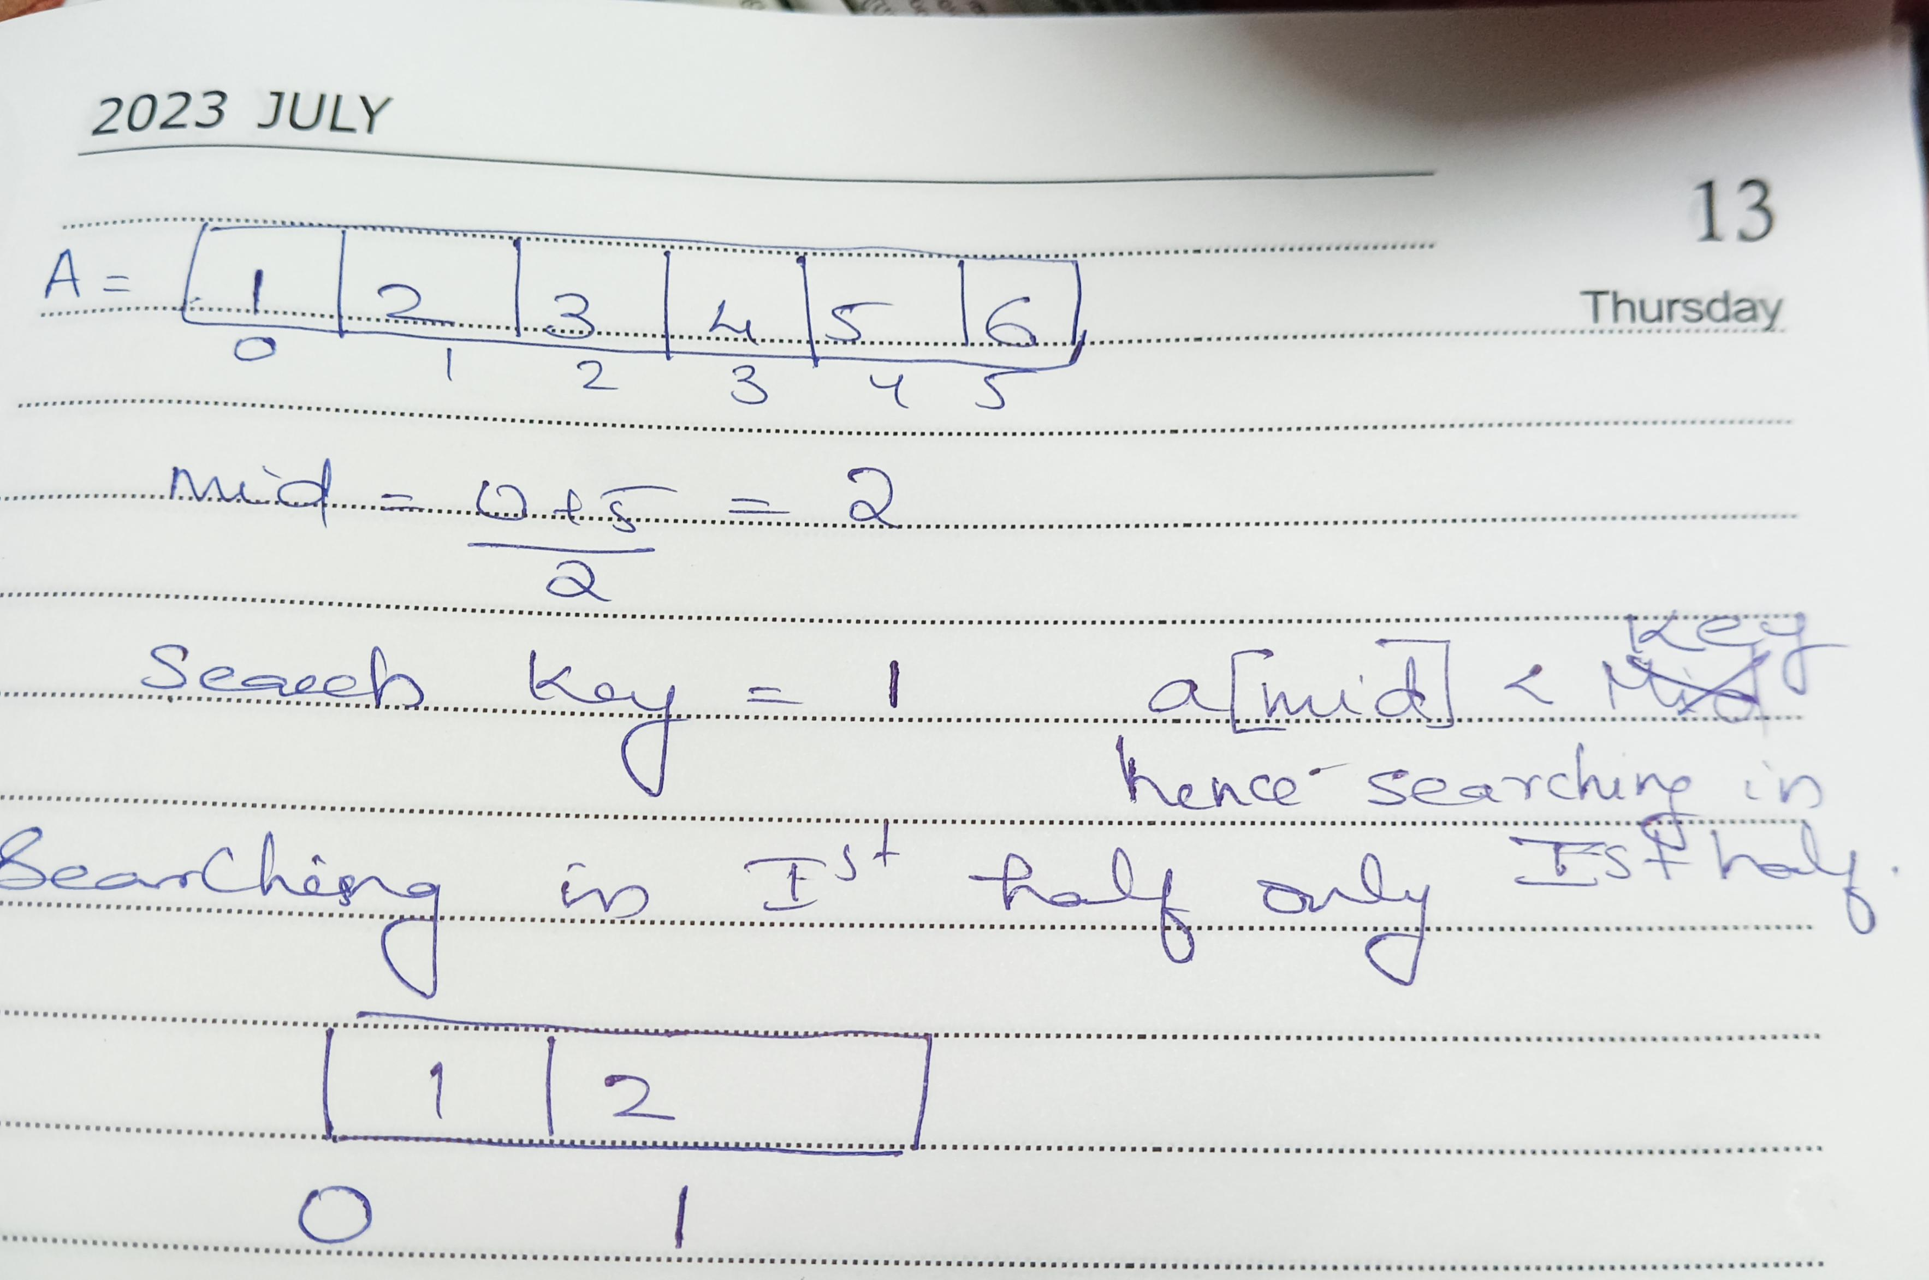
BINARY SEARCH

Slide 5
Reccurrence Relation
3 methods for solving recurrence relation
Substitution Method
Masters Method
Recurrence Tree

Slide 7
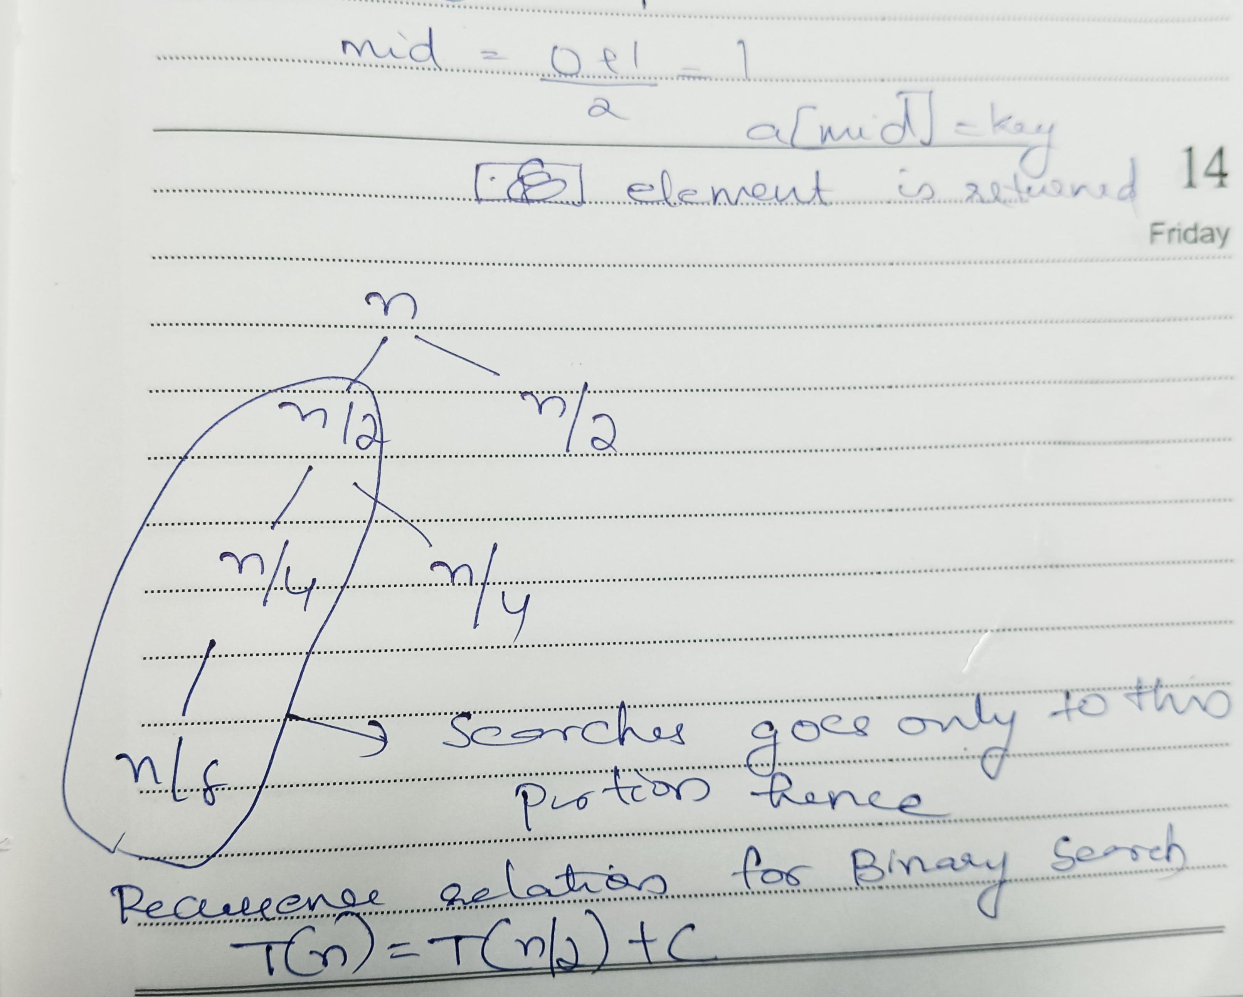
BINARY SEARCH

Slide 8
1) Substitution Method
substitution method for solving recurrence relations consists of three steps:
1.Guess the form of the solution. 2.Verify by induction. 3.Solve for constants.

Slide 9
1) Substitution Method Example-1
T(n) = T(n/2)+c if n>=1
1 if n=1

Slide 10
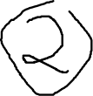



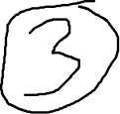

1) Substitution Method
T(n) =T(n/2) +c
T(n/2) =T(n/4) +c
T(n/4) =T(n/8) +c
T(n) =T(n/4) +c+c
=T(n/2^2) +2c
=T(n/2^3) +3c
Upto k steps
Thus T(n/2^k) +kc

Slide 11
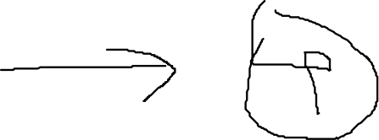
1) Substitution Method
n=2^k
=T(n/n) +kc
=T(1) +kc
=1+kc
n=2^k, taking log on both sides
logn=log 2^k
=klog2
k=logn(log2=1)
Applying the value of k to the above equation 4 it becomes 1+lognc hence O(logn)

Slide 12
1) Substitution Method-Example-2
T(n) =1 ,if n=1
2T(n/2) +n , otherwise

Slide 13
1) Substitution Method
T(n) =2T(n/2) +n
T(n/2) =2T(n/4) +n/2
T(n/4) =2T(n/8) +n/4
T(n) =2[2T(n/4) +n/2]+n
=2^2T(n/2^2) +2*(n/2) +n
=2^2T(n/2^2) +2n
=2^3T(n/2^3) +3n
=2^4T(n/2^4) +4n....... K times

Slide 14
1) Substitution Method
Then equation becomes 2^k+T(n/2^k) +kn
=2^kT(1) +kn
n =2^k
Logn=log 2^k
K=logn
Substituting in above equation it becomes
n+nlogn
O(nlogn)

Slide 15
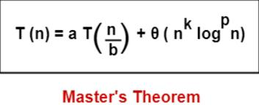
Masters Theoram
Master's Theorem is the best method to quickly find the algorithm's time complexity from its recurrence relation.
Master's Algorithm for dividing functions can only be applied on the recurrence relations of the form:T(n) = )aT(n/b)+f(n), where f(n) is

Slide 17
Master Theorem Cases-
To solve recurrence relations using Master’s theorem, we compare a with b^{k}.
Then, we follow the following cases-
Case-01:
If a > b^{k}, then T(n) = θ (n^{log}_{b}ª)
Case-02:
If a = b^{k} and
If p < -1, then T(n) = θ (n^{log}_{b}ª)
If p = -1, then T(n) = θ (n^{log}_{b}ª.log²n)
If p > -1, then T(n) = θ (n^{log}_{b}ª.log^{p+1}n)
Case-03: If a < b^{k} and
If p < 0, then T(n) = O (n^{k})
If p >= 0, then T(n) = θ (n^{k}log^{p}n)

Slide 19
Masters Theoram
N = input size (or the size of the problem) a = count of subproblems in the dividing recursive function n/b = size of each subproblem (Assuming size of each subproblem is same) where the constants a, b, and k are constants and follow the following conditions: a>=1 b>1 k>=0

Slide 20
Example1
T(n) =9T(n/3) +n
Compare with general form, hence a=9, b=3, k=1, p=0
Check whether the conditions are satisfying, then only we can solve the recurrence relation with masters theoram(a>=1, b>1, k>=0, p is real number)
compare a with b^{k}.
9>3, hence case 1 ie = θ (n^2)

Slide 21
Example 2
T(n) =2T(n/2) +nlogn
Compare with general form, hence a=2, b=2, k=1, p=1
Check whether the conditions are satisfying, then only we can solve the recurrence relation with masters theoram(a>=1, b>1, k>=0, p is real number)
compare a with b^{k}.
2=2, hence case2, in case 2there are 3cases we have to check whether p >-1, p=-1, p<-1, then θ(nloglogn)

Slide 22
Example 3
T(n) =7T(n/3) +n^2

Slide 23
Recursion Tree
Recursion Tree is another method for solving the recurrence relations.
Recursion tree is a tree where each node represents the cost of a certain recursive sub-problem.
sum up the values in each node to get the cost of the entire algorithm.

Slide 24
Recursion Tree
Steps
Draw a recurrence tree
Calculate time taken by every level of tree
Finally sum the work done at all level

Slide 25
Recursion Tree
Draw Recursion Tree
1) Start from given recurrence relation
2) last term in recurrence relation will be our root
3) Keep drawing till we find a pattern

Slide 26
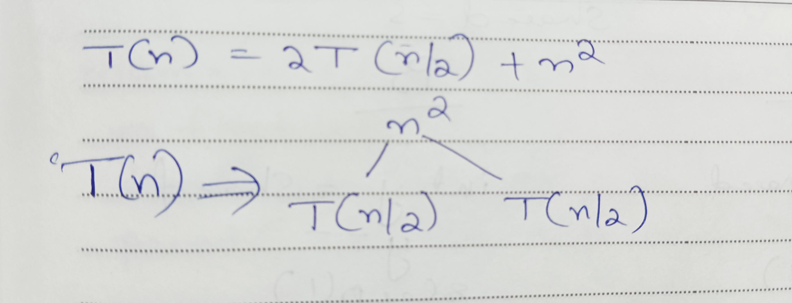
Recursion Tree
T(n) =2T(n/2) +n^2

Slide 27
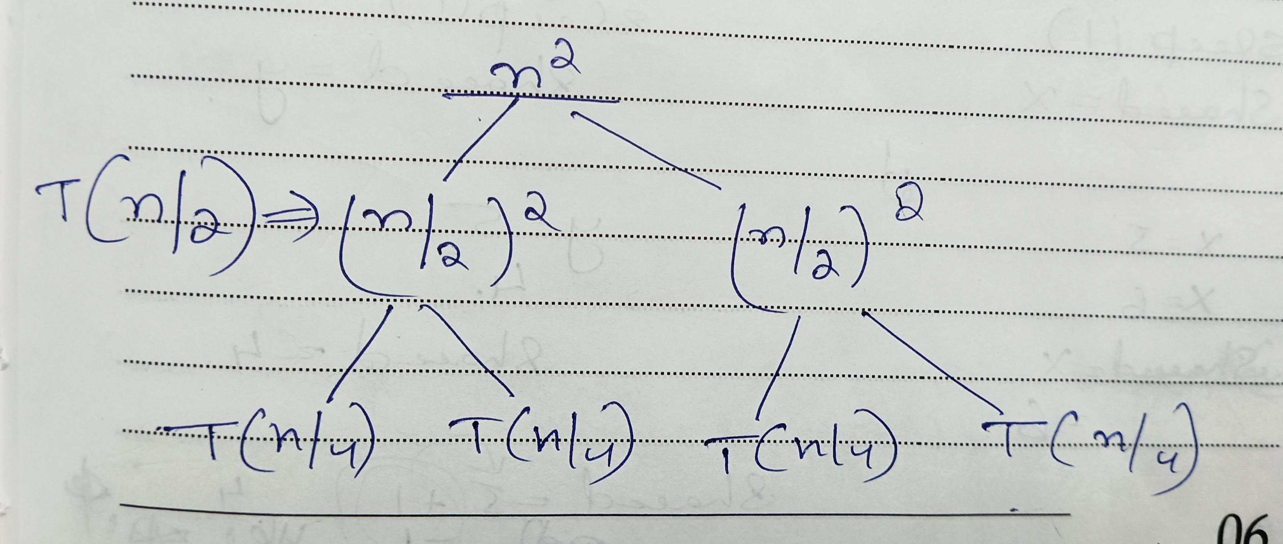
Recursion Tree

Slide 28
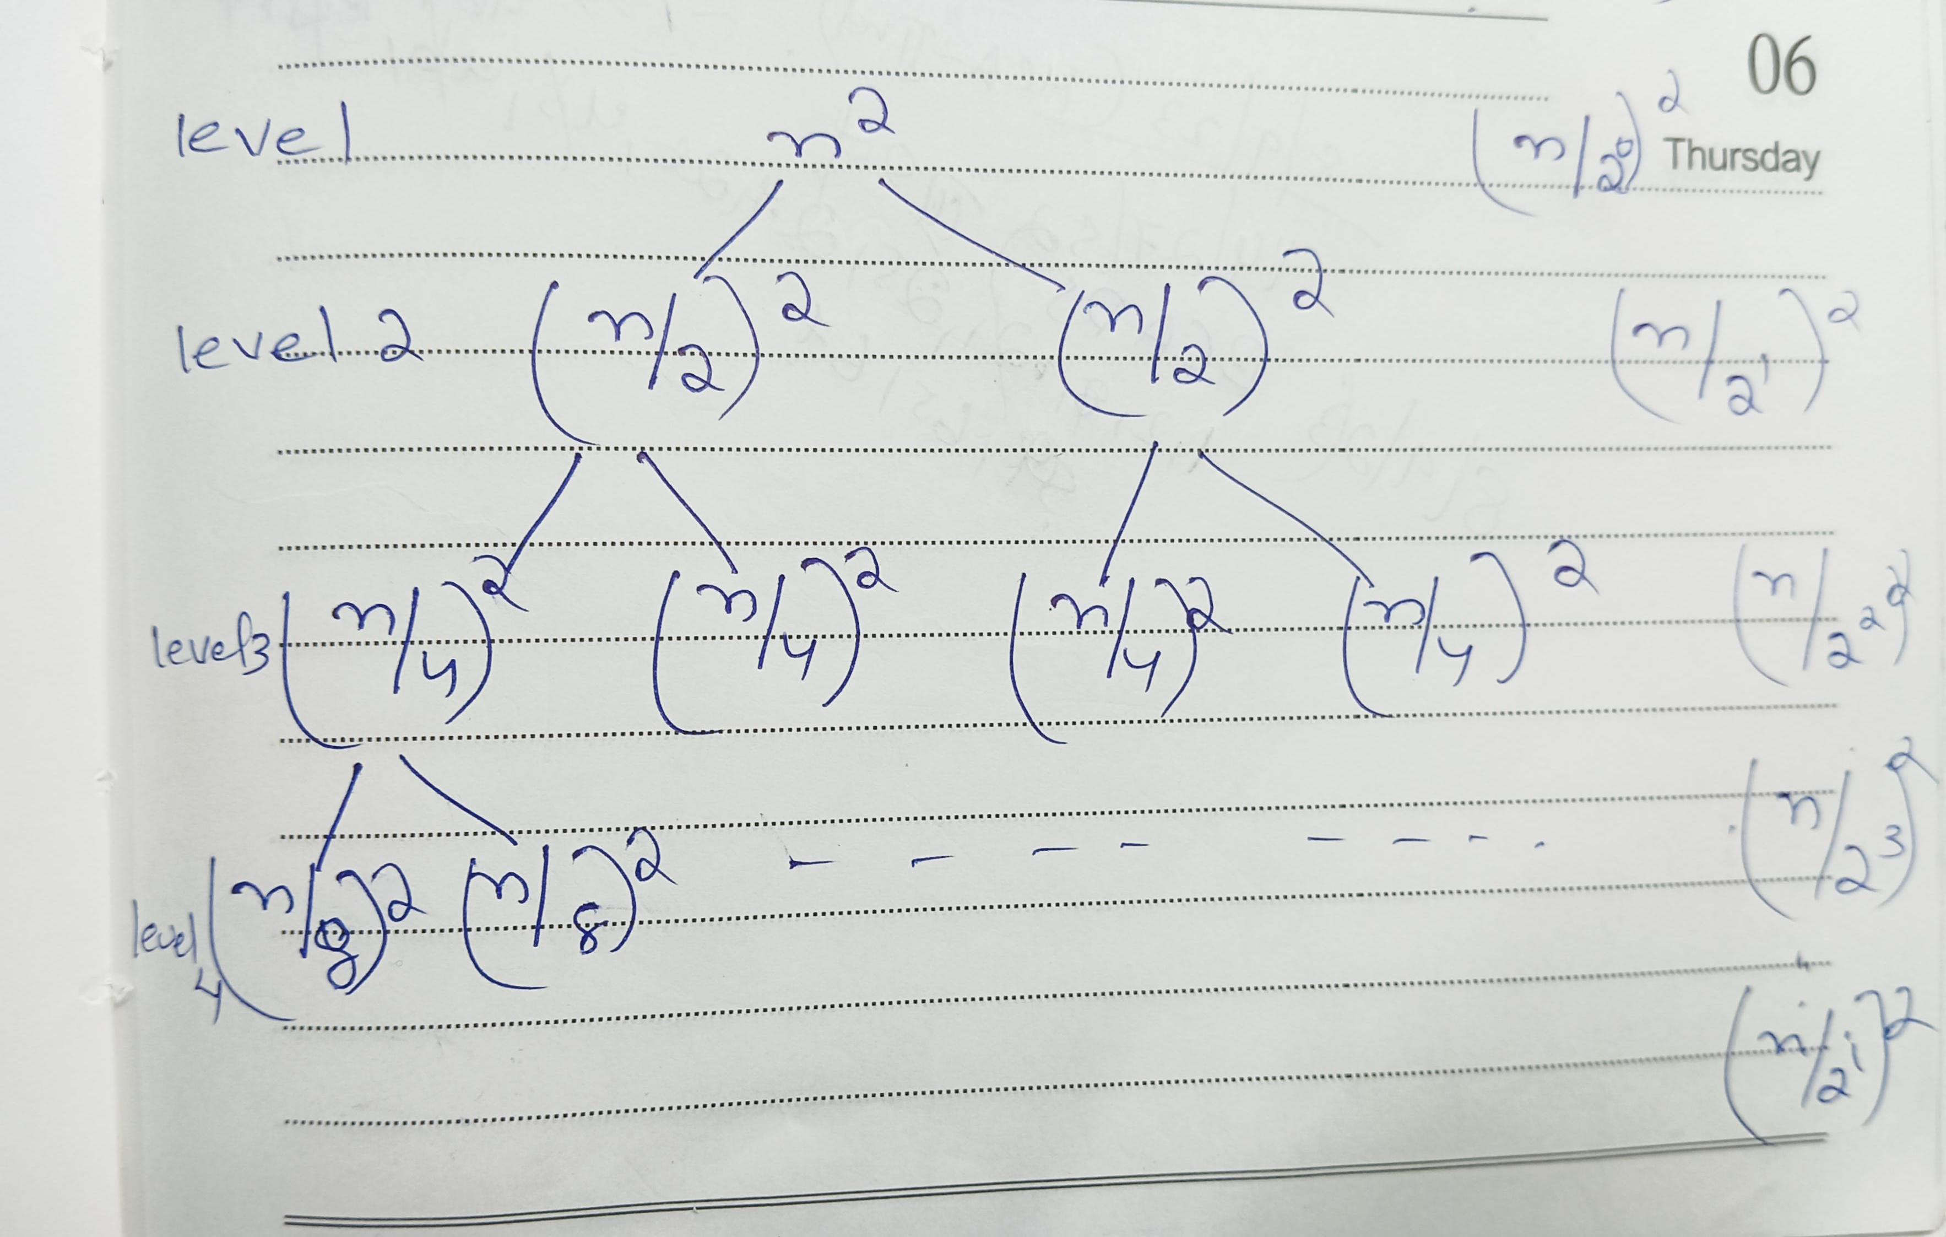
Recursion Tree

Slide 29
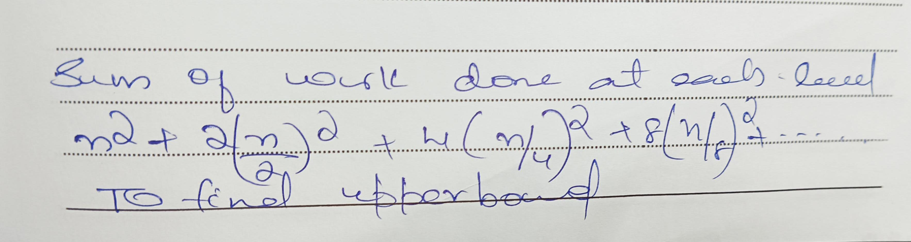
Recursion Tree

Slide 30
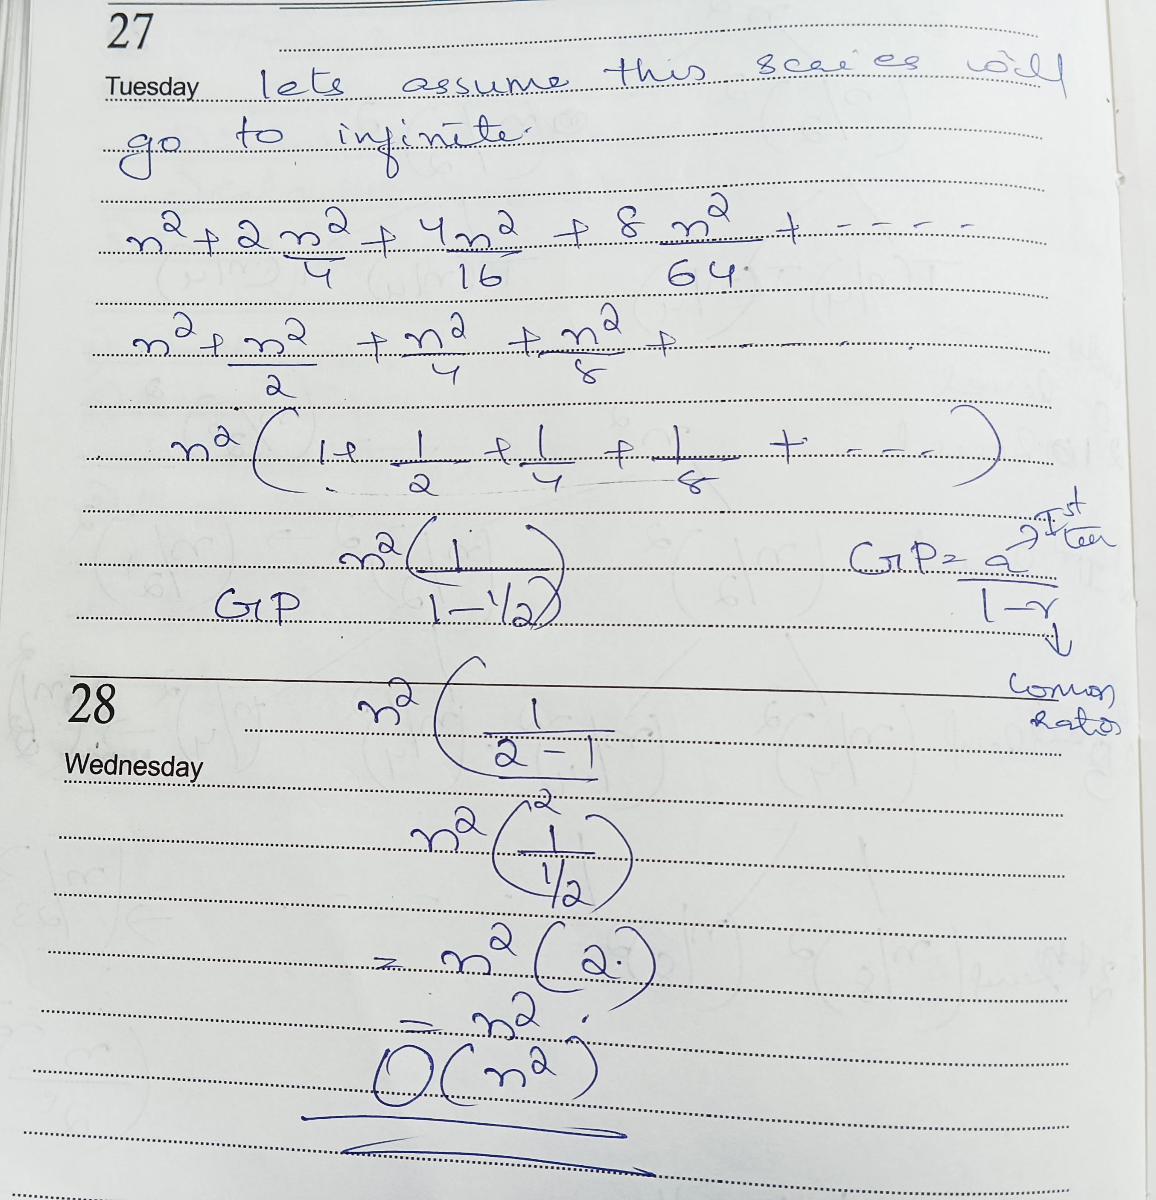
Recursion Tree

